Slide 1
Computational Physics (Lecture 9)
PHY4061

Slide 2
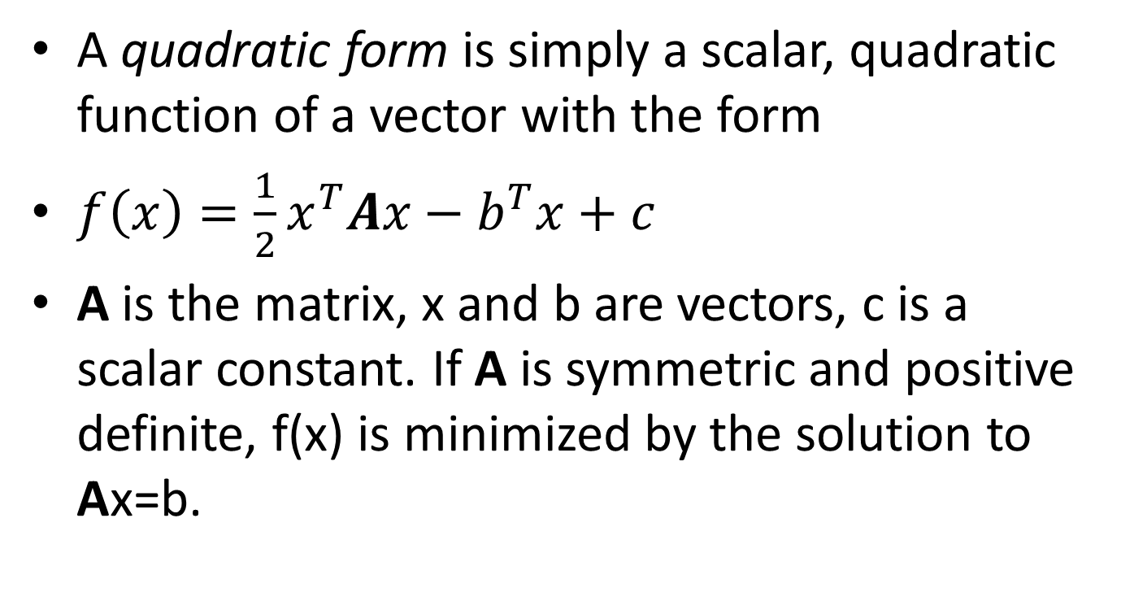
Quadratic form
A quadratic form is simply a scalar, quadratic function of a vector with the form
$f\left(x\right)=\frac{1}{2}x^{T}Ax−b^{T}x+c$
A is the matrix, x and b are vectors, c is a scalar constant. If A is symmetric and positive definite, f(x) is minimized by the solution to Ax=b.

Slide 3
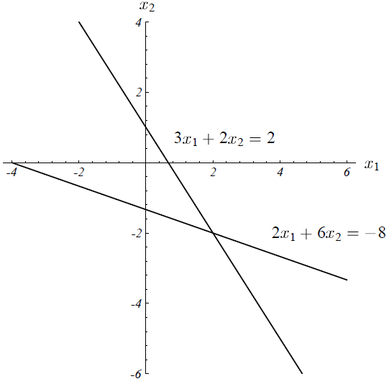

Sample Problem:
$A=\left[\begin{matrix}3 & 2 \\ 2 & 6\end{matrix}\right], b=\left[\begin{matrix}2 \\ −8\end{matrix}\right],$ c= 0

Slide 4
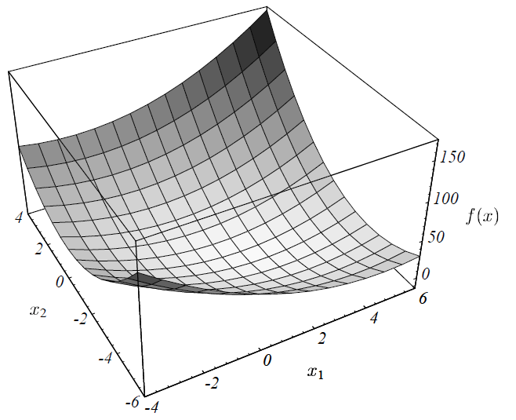

Slide 5
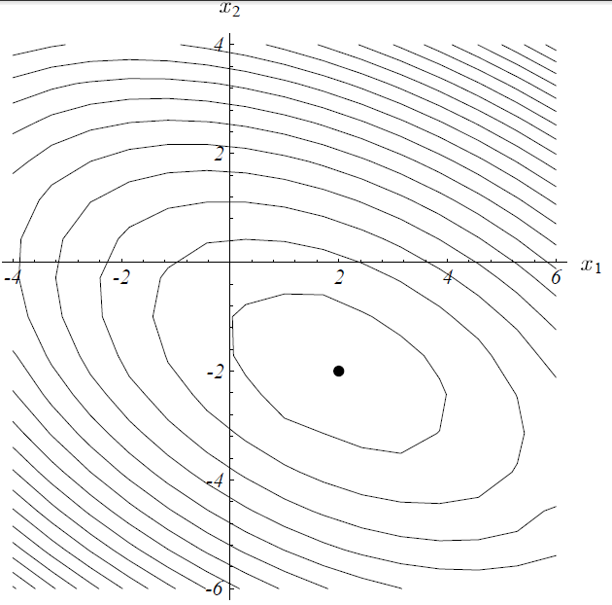
Contour map

Slide 6
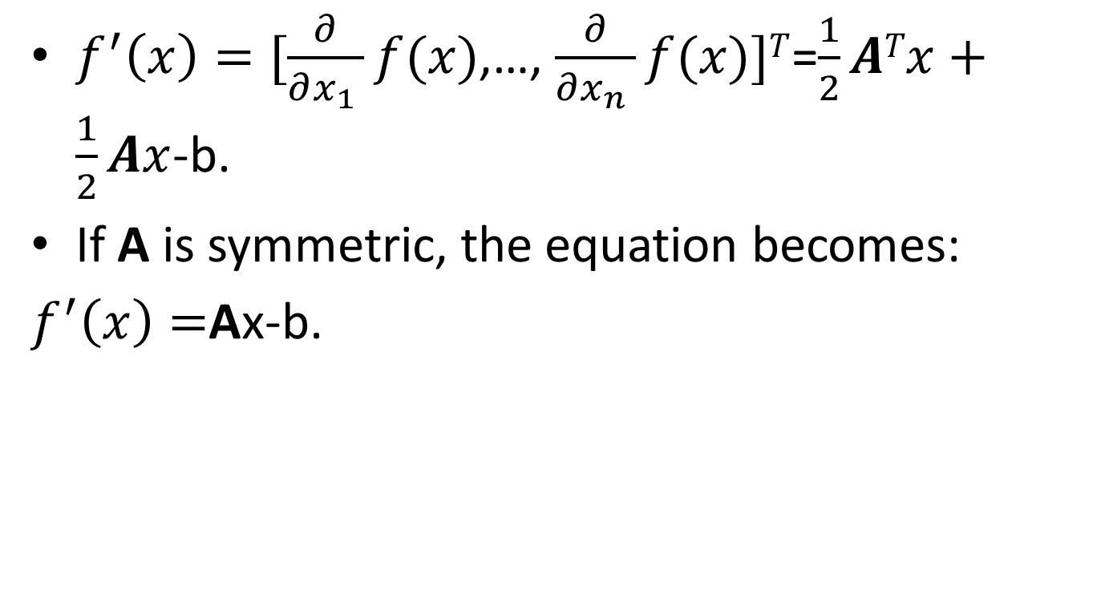
The gradient
$f^{′}\left(x\right)=[\frac{∂}{∂x_{1} }f(x)$,…, $\frac{∂}{∂x_{n} }f(x)]T$=$\frac{1}{2}ATx+\frac{1}{2}Ax$-b.
If A is symmetric, the equation becomes:
$f^{′}\left(x\right)=$Ax-b.

Slide 7
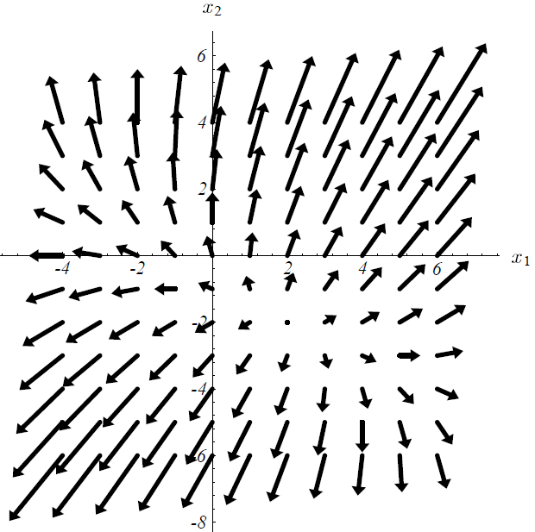

Slide 8
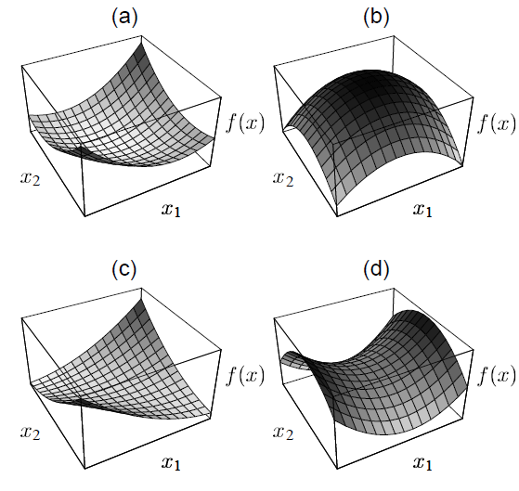

Slide 9
Revisit of Steepest descent
We start from an arbitrary starting point: x₀,
Slide down to the bottom of the paraboloid.
When we take the step, we choose the direction in which f decreases most quickly.
-f’(x_{i})=b-Ax_{i}.
Error : e_{i} = x_{i}-x => how far from the solution.
Residual: r_{i} = b-Ax_{i} => how far from the correct value of b.
r_{i} = -Ae_{i}
Residual: error transformed by A with into the same space of b.
Direction of steepest descent.

Slide 10
Suppose we start from (-2, -2). Along the steepest descent, will fall somewhere on the solid line.
X₁ = x₀+αr₀
How big the step we should take?
Line search
Choose α to minimize f. df(x₁)/dα=0,
So, f’(x₁)^{T}r₀=0
So α is chosen to make r₀ and f’(x₁) orthogonal!

Slide 11
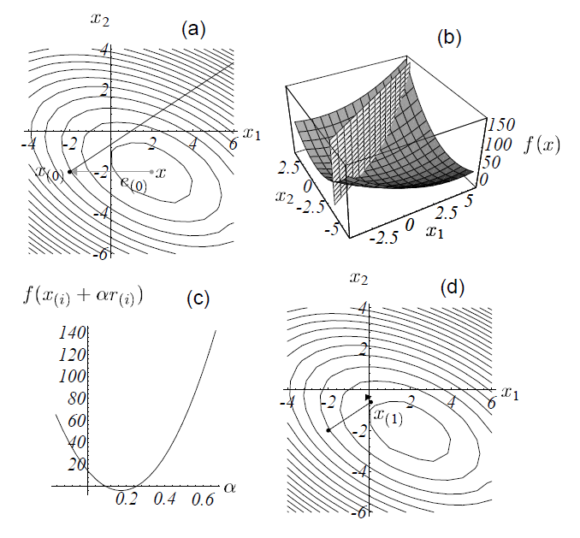

Slide 12
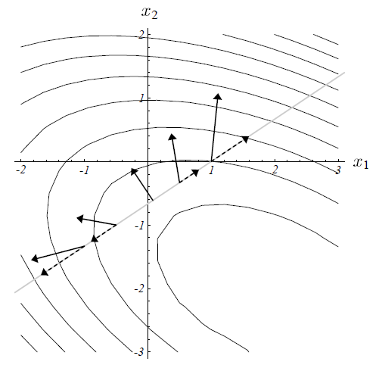

Slide 13
Determine α
F’(x₁)= -r₁
r₁^{T}r₀ = 0
(b-Ax₁)^{T}r₀ = 0
(b-A(x₀+ αr₀))^{T}r₀ = 0
(b-Ax₀)^{T}r₀ = α(Ar₀)^{T}r₀
r₀ ^{T}r₀= αr₀^{T}(Ar₀)
α =(r₀ ^{T}r₀)/ (r₀^{T}Ar₀)

Slide 14
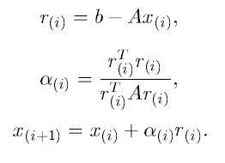
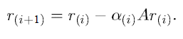
General method of Steepest Descent

Slide 15
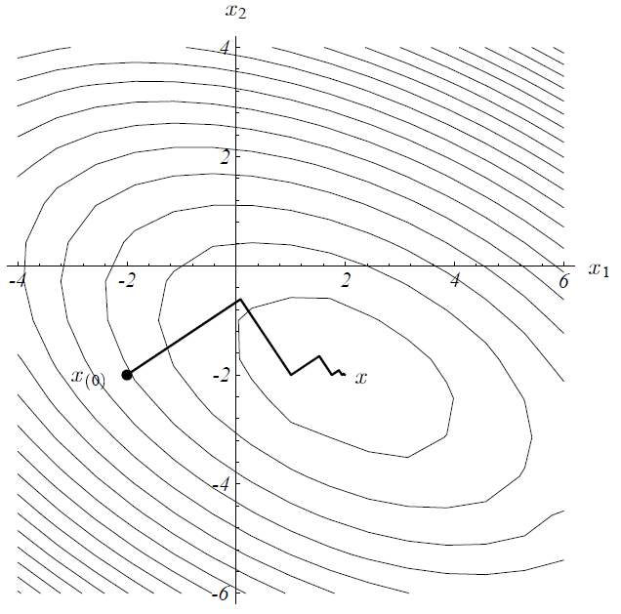
Any problems can you perceive?

Slide 16
Conjugate directions
SD often takes steps in the same direction!
If we take n orthogonal steps, d₀, d₁ … d_{n-1}, each step has the correct length, after n steps, we are done！
In general, for each step, we have
x_{i+1}=x_{i}+α_{i}d_{i}
e_{i+1} should be orthogonal to d_{i}
d_{i}^{T}e_{i+1} = 0 (e_{i+1} = x_{i+1}-x= e_{i}+ α_{i}d_{i})
d_{i}^{T} (e_{i}+ α_{i}d_{i})=0
α_{i}=-d_{i} ^{T}e_{i}/(d _{i} ^{T}d _{i})

Slide 17
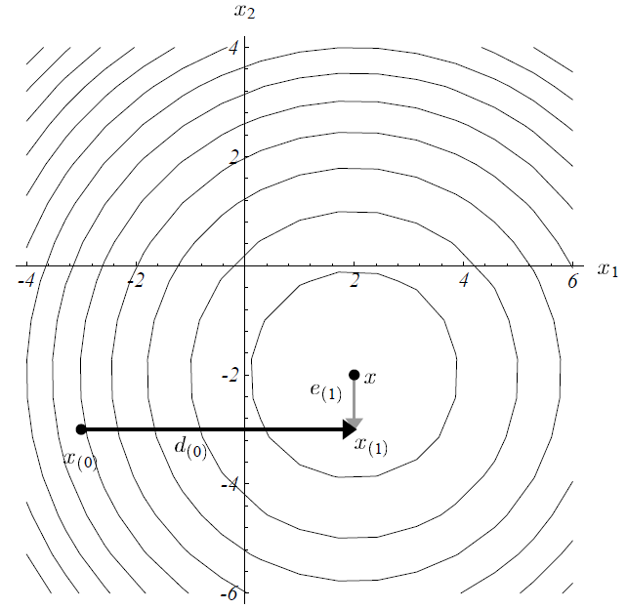

Slide 18
Useless! We don’t know e_{i}.
Instead, we make d_{i} and d_{j} A-orthogonal, or conjugate.
d_{i} ^{T}Ad_{j} = 0

Slide 19
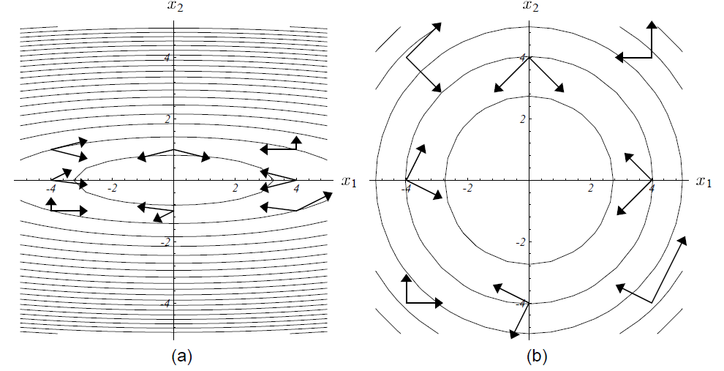

Slide 20
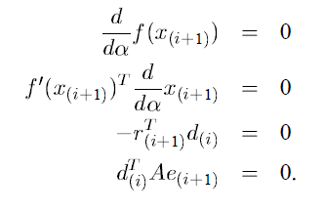
New requirement:
e(i+1) is A-orthogonal to d(i)
Like SD, we need to find the minimum along d(i)
Here, x_{i+1}=x_{i}+α_{i}d_{i}
A e _{i+1} = A (x_{i+1} –x) = Ax_{i+1}-Ax=Ax_{i+1}-b = -r_{i+1}

Slide 21
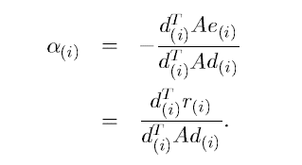
This time, evaluate the α(i) again,
A e _{i} = A (x_{i} –x) = Ax_{i}-Ax=Ax_{i}-b = -r_{i}

Slide 22
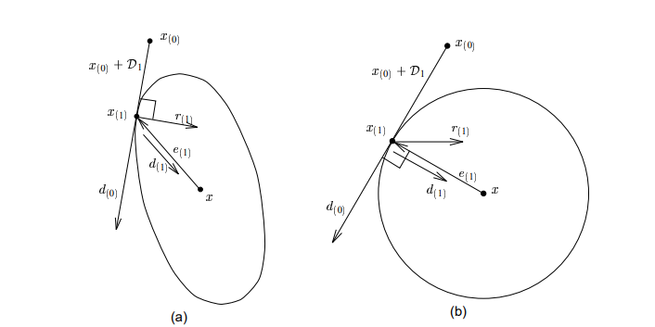

Slide 23
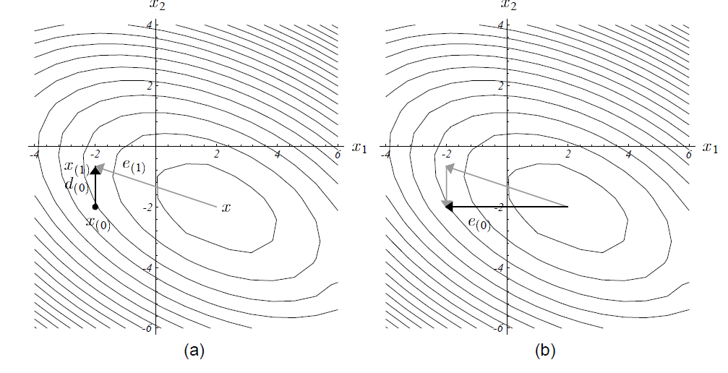

Slide 24
Conjugate Gradients
Reading material:
https://www.cs.cmu.edu/~quake-papers/painless-conjugate-gradient.pdf
Just the Conjugate directions method where the search directions are constructed by conjugation of the residuals.
u_{i}=r(_{i})

Slide 25
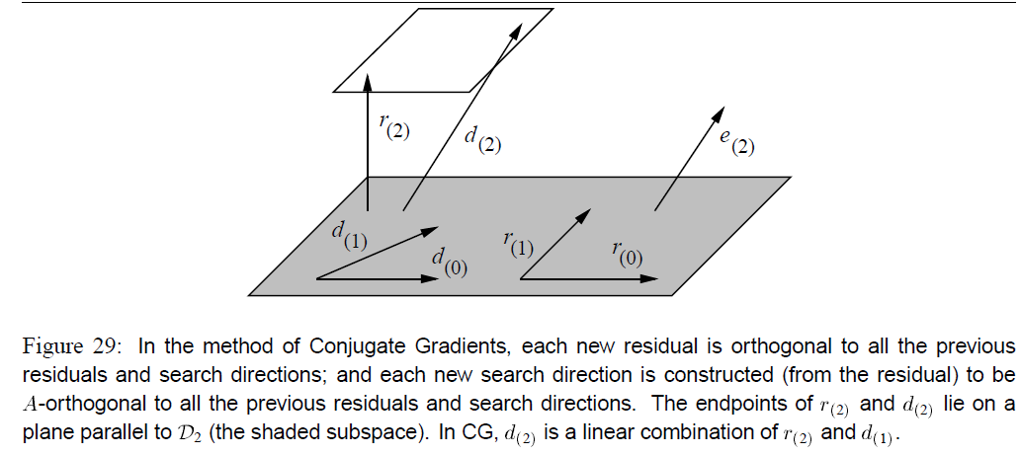

Slide 26
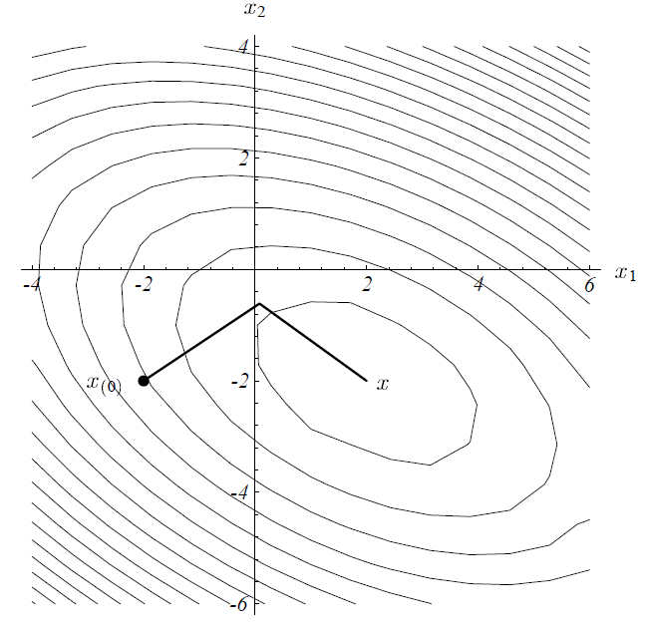

Slide 27
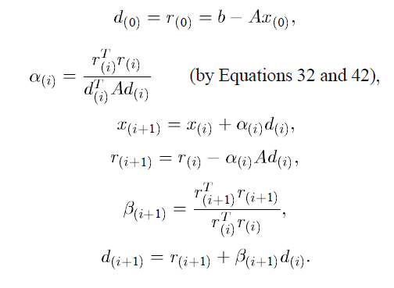
General Method

Slide 28
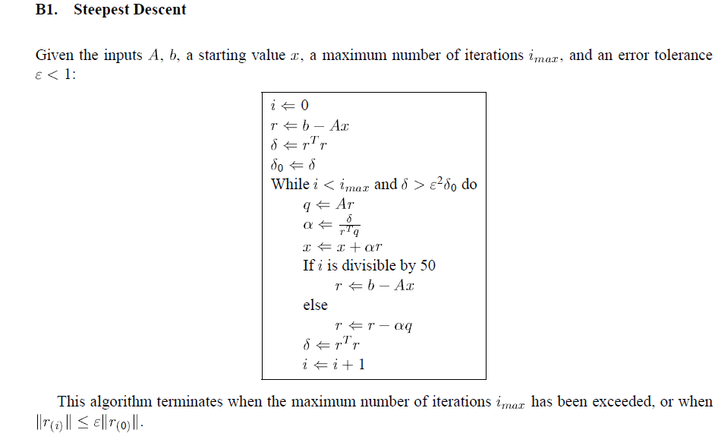
Sample code for SD

Slide 29
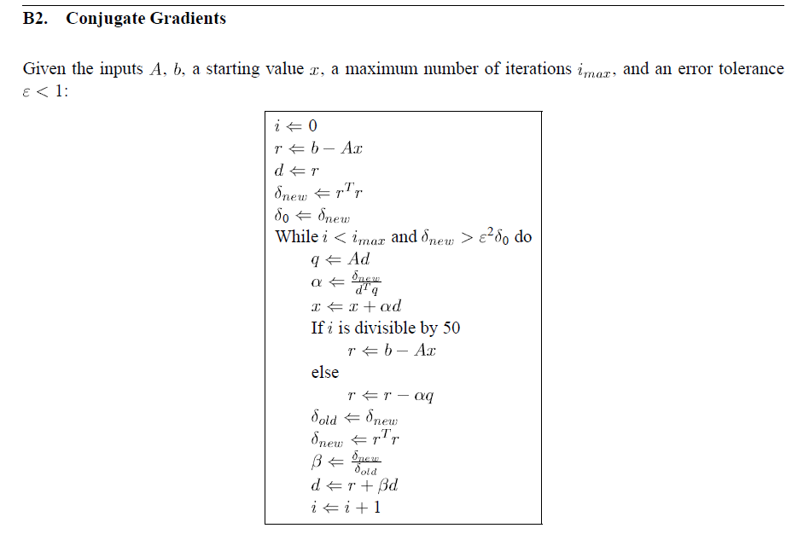

Slide 30
[

Slide 31
Revised Algorithm using line minimization for nonlinear functions

Slide 32
Metals
How about the metals?
Metals are characterized by a rare gas shell plus a number of valence electrons.
Pair potentials do not work terribly well because the electrons are very much delocalized.
If one does use a pair potential, it must be softer than the Lennard-Jones form, for example a Morse potential (sum of exponentials.)
The major problem with pair potentials for solid metals is that they have no environmental dependence so that a bulk atom is too much like a surface atom.

Slide 33
One popular empirical potential for metals is the embedded-atom-method (EAM) potential. It is based on the basic idea of jellium model that “metallic bonding” involves ions in an electron sea (jellium)
so the total potential energy
is the sum of direct ion-ion interaction (for example to keep to ion cores from overlapping) and the interaction between an ion and the electron sea.
One assumes that locally there is an electron charge density coming from the nearby ions and that the energy and interaction are some function of this density.
This later term is then a true many-body potential.
The EAM potential works well for spherically symmetric atoms such as Cu, Al, Pb. Some references are Daw and Baskes, Phys. Rev. B 29, 6443 (1984) and Foiles, Baskes and Daw, Phys. Rev. B 33, 7983 (1986).
Tight-binding potentials are another possible functional forms for treating metals, especially for transition-metal solids.

Slide 34
Metal: EAM potential:

Slide 35
Biomolecular Sytems
For other systems there are extensive codes which handle real biomolecular systems (GROMOS, CHARM, AMBER ...) They use an experimental data base and put in specific terms for bond lengths, bond angles, torsion angles. etc.
complicated because they have to distinguish between many local bonding arrangements!
Even so, one should never fully trust the accuracy of the empirical potentials.
The errors can still be quite large even if a lot of data has been put in. This is because the potential surface is so highly dimensional and there are so many different possible combinations of atoms that experiment can only hope to sample a very few of them.

Slide 36
Project A part III total energy calculation
(30%) Write a subroutine for total energy calculation implementing the Lennard-Jones potential.
(70%) Write a subroutine for total energy calculation implementing one of the following potentials at your preference:
EAM potential for metals,
SW or Tersoff potential for Si, or
Coulomb potential for ionic solids with Buckingham potential.
You need to apply PBC for distance and vector calculation. If you choose a or b, you’ll get 10% bonus, however the total score is capped at 100%.
You need to check literatures for all the related parameters. Also make sure to include your references in your report.
If your code is correct, the total energy per atom is a constant when you increase the periodicity for a given cutoff.

